Slide 1
Coach Notes
In this lesson debugging messages will appear frequently in the shell, make sure students know to ignore these since they look like errors.
The voice recognition is not the most accurate so the light may not work as the students want all the time.
The SpeechDetection() class is made here in preparation for the final project and the Level 4 class where it will be reused.

Slide 2
Machine Learning with Raspberry Pi
Speech Recognition
AI Code Academy

Slide 3
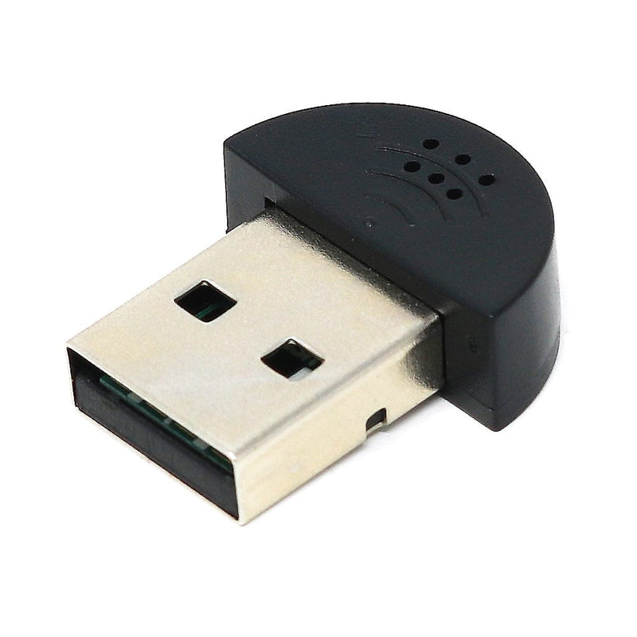
Materials Needed
For this lesson, we’ll need the following materials:
Raspberry Pi with SSH and VNC connection
USB Microphone
USB Speaker
LED
220 Ohm Resistor

Slide 4
Speech Recognition
Speech recognition is the process of converting words people speak into text a computer can use.
Many different devices employ speech recognition like AI assistants like Amazon Alexa and keyboards that allow speech input.
Have you use speech input or another form of speech recognition before?
How well did it work?

Slide 5
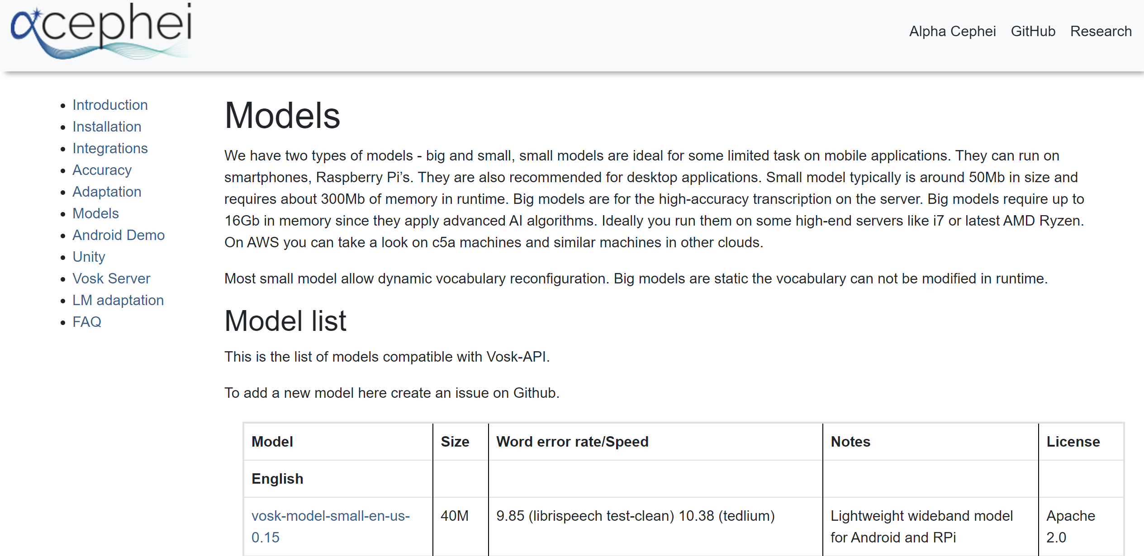
Speech Recognition
For our project today we are going to make use of a speech recognition machine learning model to turn our speech into text.
We will be using the vosk and kaldi machine learning models to help us convert our speech into text.
To use the models, we need to download it from their website. Please go to the following link on the PI. https://alphacephei.com/vosk/models
Click on “vosk-model-small-en-us-0.15” to download the model.

Slide 6
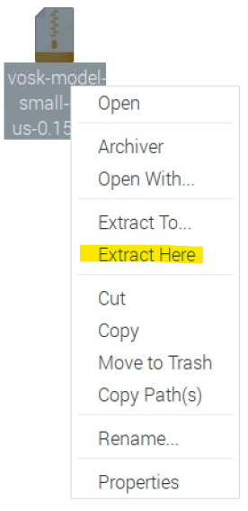

Vosk Speech Recognition
Move the downloaded file to the folder you are going to write your code in and right click on the file and press extract here.
This will create a folder containing all the vosk model data. Feel free to rename the folder to a name that is shorter, we will need to use the name model in our code.
Inside the created folder:

Slide 7
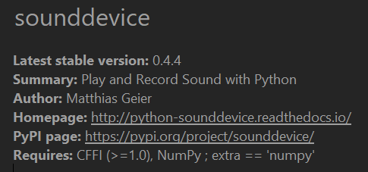
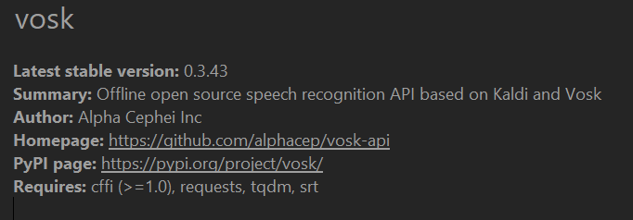
Module Install
Install the sounddevice and vosk modules and using the Thonny package manager.
They are necessary for our project today.

Slide 8
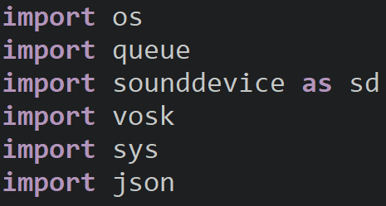
speech_detection_utils.py
We are going to create a file that will act as a module for us to use speech detection.
Inside the file we will import the following modules:
Queue: will create the queue data structure for us to store frame data in.
Sounddevice: will allow us to read audio input from the microphone.
Vosk: will allow us to use the vosk model
Json: will allow us to convert a string formatted as JSON into a dictionary

Slide 9
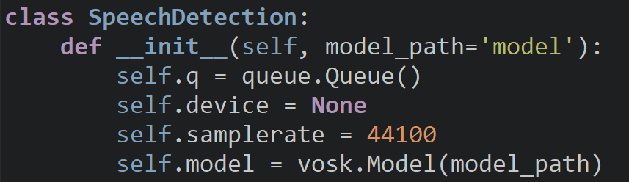
SpeechDetection Class
We will create the SpeechDetection class which will recognize speech and return text.
The constructor requires the file path of the folder we created; you can set the default value to the name of your model folder.
We will then set some constants for our audio input and create a variable to store the model and queue.
We will use the default device index for the input and sample at 44.1kHz.
If you have multiple input devices, use the mic’s index.

Slide 10
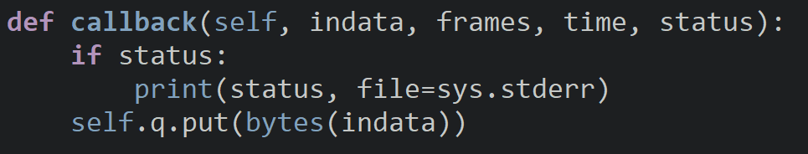
callback()
The callback function will print out status data if there is status data and add the microphone data to the queue in byte form.
The callback function is called in a separate thread and runs alongside our main program.

Slide 11
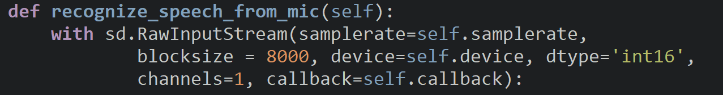
recognize_speech_from_mic()
recognize_speech_from_mic() reads the microphone input and uses the vosk and kaldi models to return what the text is.
We will create the input stream and provide the setup parameters. If you get an input overflow, increase the blocksize.

Slide 12
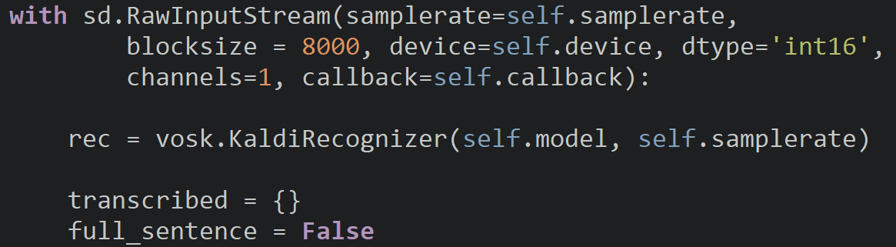
recognize_speech_from_mic()
After we begin our input stream, create an instance of the Kaldi Recognizer and pass it the sample rate and model.
The transcribed dictionary stores the words we speak, and the full sentence Boolean indicates when we are done speaking.

Slide 13
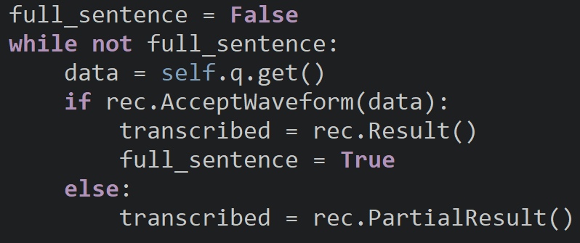
recognize_speech_from_mic()
Microphone data will be read from the queue until we have transcribed a full sentence.
While the user is talking, the partial result is saved into transcribed.
Transcribed will be set to the Kaldi result once the user finishes talking and full_sentence is set to true to end the loop.

Slide 14
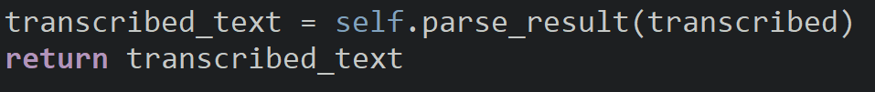
recognize_speech_from_mic()
At the end of our function, we call parse_result and save the result into transcribed text and return the text it detected as a string.

Slide 15
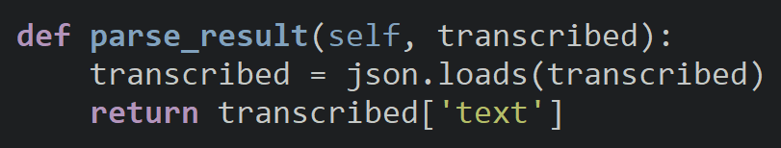
parse_result()
The text we record will be stored in a string formatted in JSON.
We need to load it into a JSON object, converting it to a Python dictionary.
To get the text we spoke, we just need to index the dictionary with the key text.
example: {"result" : [{
"conf" : 0.437097,
"end" : 0.420000,
"start" : 0.000000,
"word" : "these"
}, {
"conf" : 1.000000,
"end" : 1.500000,
"start" : 0.870000,
"word" : "test"
}],
"text" : "these test"}

Slide 16
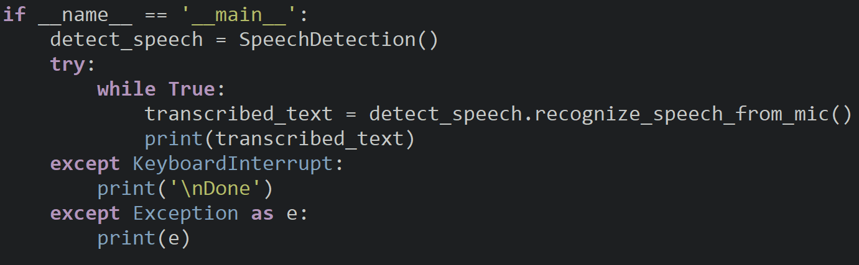
Program Entrance
When we run the file as a main program, it will detect speech from the microphone and print out its detected speech.

Slide 17
Try It Out
Was it able to identify the words you spoke?
Were there some issues in the voice detection?

Slide 18
Voice Activated Lights
We are now going to use the speech recognition model to increase the brightness or dim the LED.
We will create a text model on AICODE101 to ensure that more phrases work with the model.

Slide 19
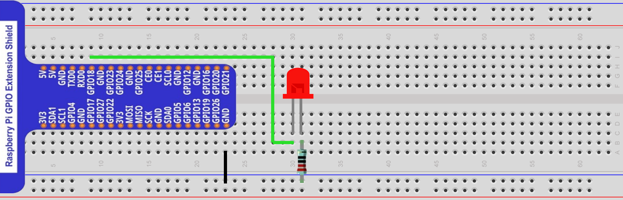
Project Circuit
The LED is connected to GPIO18, if you choose a different pin, make these adjustments in your code.

Slide 20
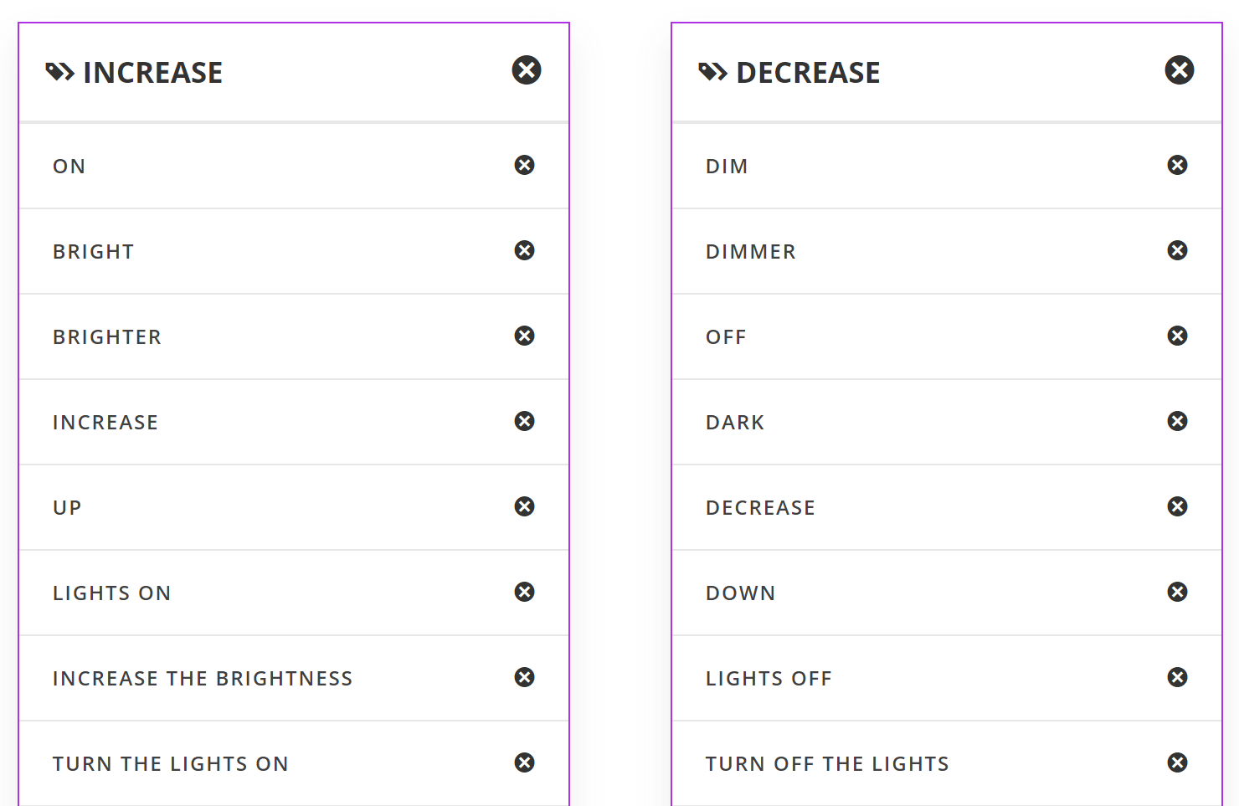
Text Model
Create a text model on AICODE101 and add two labels for increasing the brightness and decreasing the brightness of the LED.
Add more phrases to improve the accuracy of your model.

Slide 21
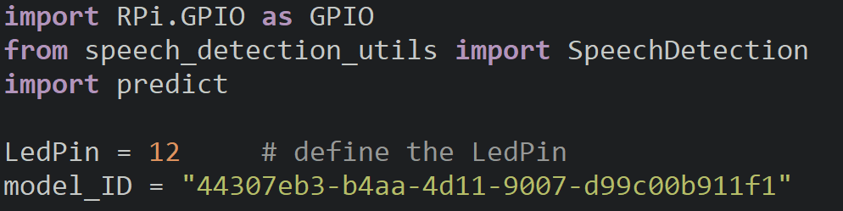
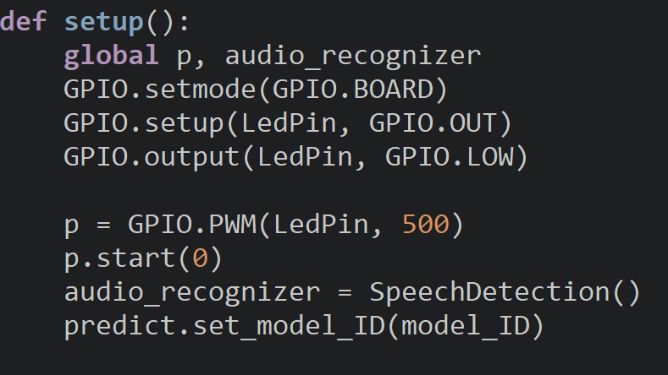
Setup
Import the GPIO, predict and speech detection modules, and create variables to store the LED pin and model ID.
Inside the setup function, configure the board and pins, create a PWM pin and an instance of SpeechDetection.
Set the model ID to enable the use of our text model.

Slide 22
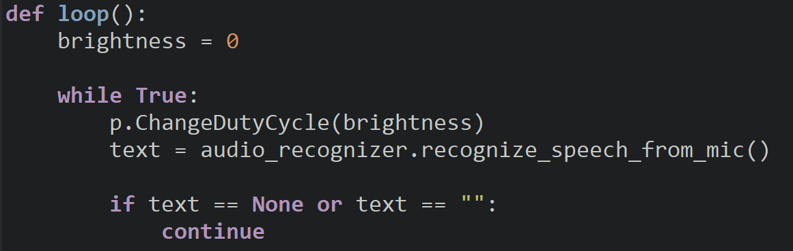
Loop
Inside the loop brightness keep track of the LED pin’s duty cycle.
In the loop, change the duty cycle of the LED and retrieve the text detected from the microphone.
To prevent our code from crashing, we will add a check to make sure that text was returned and that it doesn’t equal an empty string.
If so, we will restart the loop with continue.

Slide 23
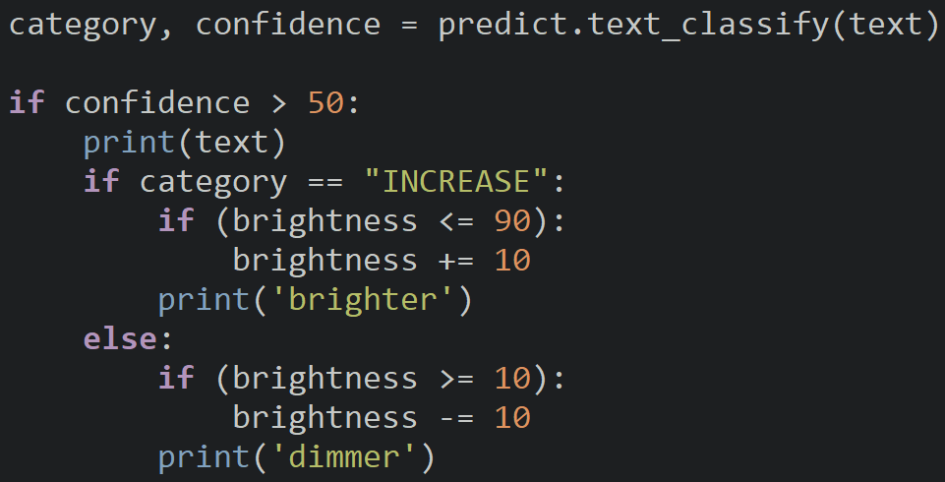
Loop
Use your model to classify the text and retrieve the category and confidence rating.
If the confidence is greater than 50, we will accept the classification and print the text for debugging purposes.
If INCREASE is the category, increase the brightness if the value is less than or equal to 90.
Otherwise, decrease the brightness if the brightness is greater than or equal to 10.

Slide 24
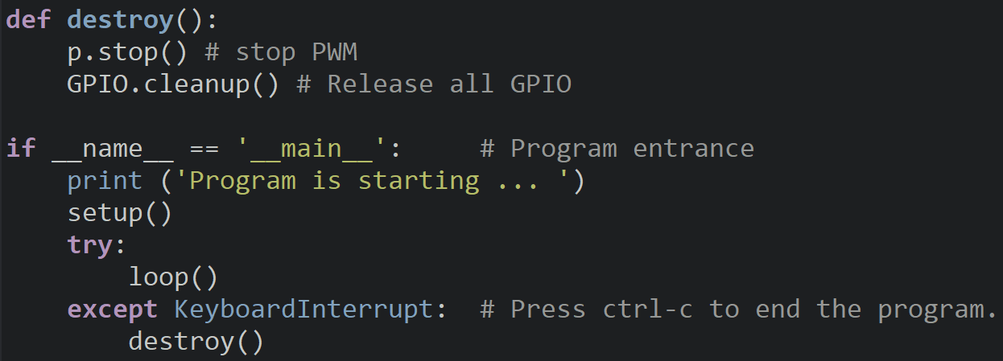
Destroy & Entrance

Slide 25
Discussion
How well did the speech recognition work?
Where you able to dim and brighten the LED with your voice?
What projects could you use the speech recognition model in?

Slide 26
Power off
As usual, shut down your pi properly before disconnecting power.

